Slide 1
INFO6003 Lab-01 (You might not need all 10 slides)
Gihan Shamike Liyanage
1142109

Slide 2
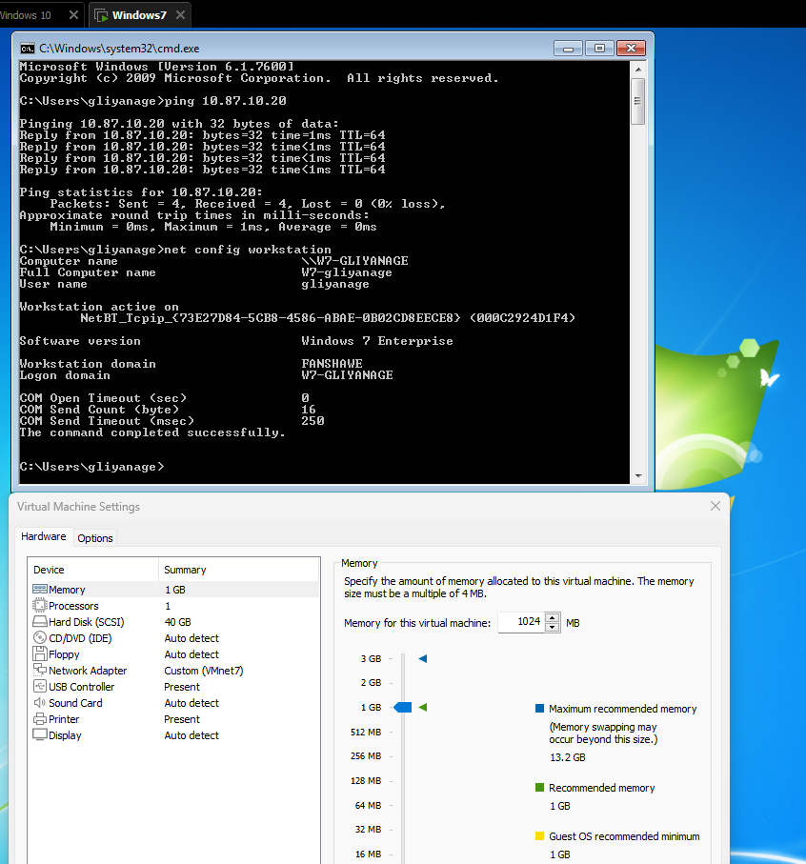
Slide #1

Slide 3
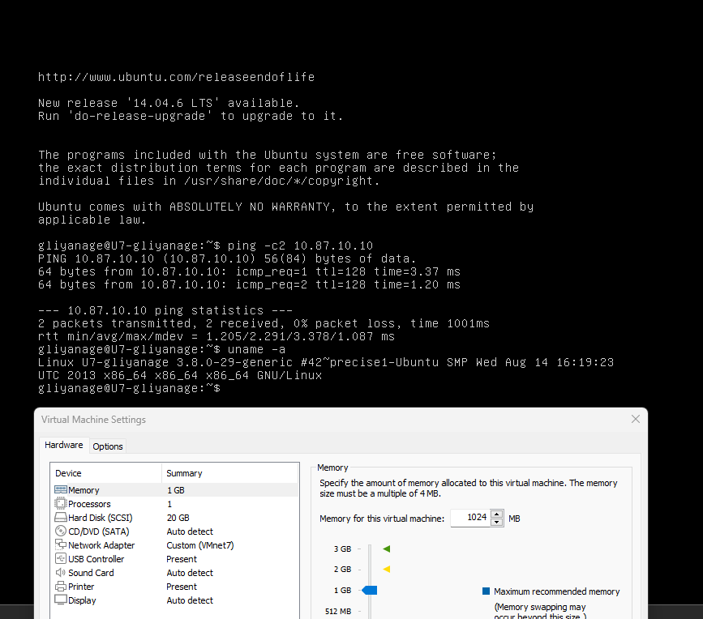
Slide #2

Slide 4
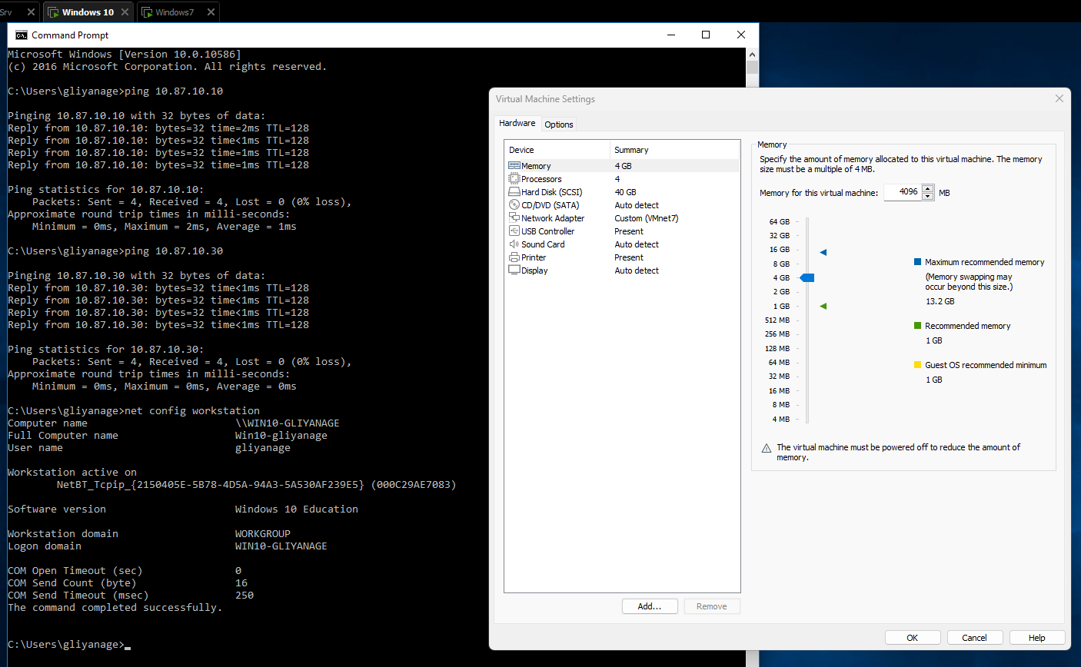
Slide #3

Slide 5
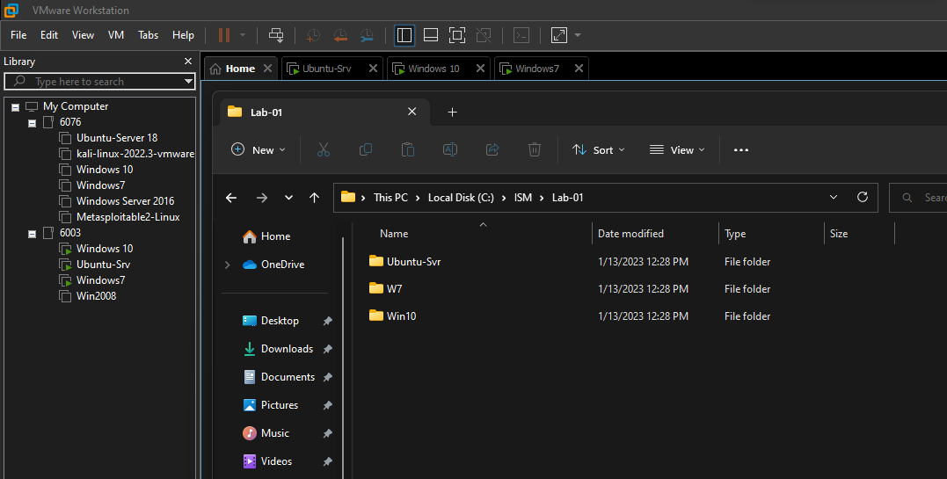
Slide #4

Slide 6
Slide #5

Slide 7
Slide #6

Slide 8
Slide #7

Slide 9
Slide #8

Slide 10
Slide #9

Slide 11
Slide #10

